Slide 1
Finding Relative Magnetic Field strength of molecular cloud by using polarization data
Adviser:
Prof Li Hua Bai
Dr Leung Po Kin
Frank
Kwan King Hong Paros
1155016751
2014/14/5

Slide 2
Motivation
To study star formation process ultimately
To understand what role does magnetic field play in star formation
However, methods of finding the magnetic field(B field) in star forming region is not good enough
Try to use the geometry of B field to estimate Relative B field strength , and carry out some experiment

Slide 3
A slide for reviewing other methods to probe B field strength
1.Zeeman splitting method : Make use of magnetic moment of molecule
Too weak to observe
2.Chandrasekhar-Fermi method (1953) : To find the mean field strength by angular dispersion
Result affected by many factor : turbulence , gravatation etc. (Hildebrand2009)
Notes:
Dispersion of angle : larger dispersion , weaker b field
Not a direct measure
http://iopscience.iop.org/1538-4357/616/2/L111/fulltext/18869.text.html
Zeeman : resolution week
Circular polarize for perp. Light

Slide 4
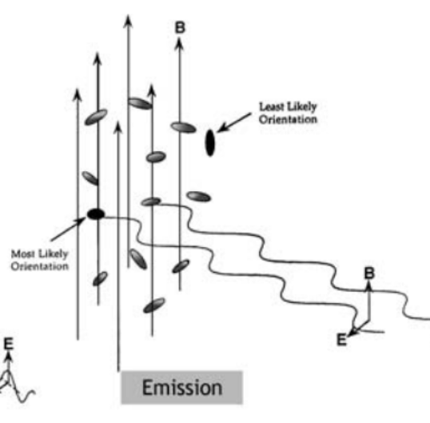
Theory : Dust grain alignment
Another tracer for magnetic field direction perp. to line of sight (e.g. Hildebrand 1988, Lazarian 2000)
Orientation of dust give polarization of light
Make use of polarization
map
Compose of Si, Mg etc
Paramagnetic
Size ~ 10⁻⁵ cm
http://www.uapress.arizona.edu/onlinebks/PPIV/chap09.pdf
Notes:
350 is window
1largest moment of inertia
http://articles.adsabs.harvard.edu/cgi-bin/nph-iarticle_query?1988QJRAS..29..327H&amp;data_type=PDF_HIGH&amp;whole_paper=YES&amp;type=PRINTER&amp;filetype=.pdf
http://articles.adsabs.harvard.edu/cgi-bin/nph-iarticle_query?2000ASPC..215...69L&amp;data_type=PDF_HIGH&amp;whole_paper=YES&amp;type=PRINTER&amp;filetype=.pdf

Slide 5
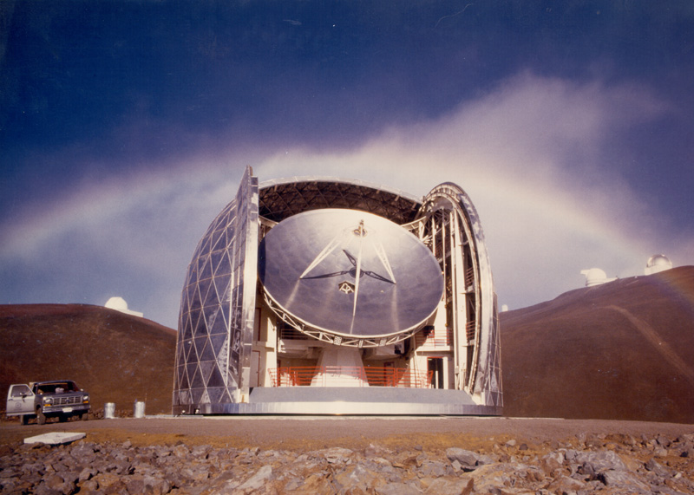
Theory : Polarization map data
Data is from 350 μm Polarimeter at CSO (Hildebrand 2010)
Data with degree of polarization P ≥3σ_{p}
http://cso.caltech.edu/

Slide 6
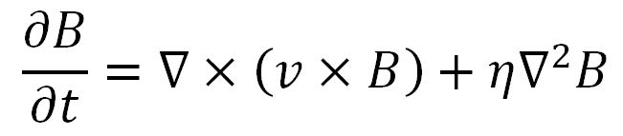
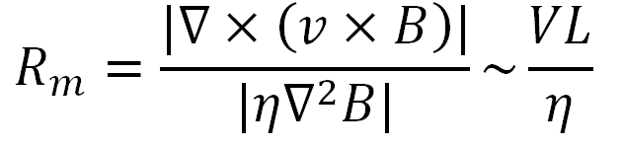
Theory : B-ρ relation
The governing equation : MHD!!!
Define magnetic Reynolds number :
velocity scale
Length scale
Magnetic diffusivity
Notes:
Convection term
Diffusion term
Eta

Slide 7

Theory : B-ρ relation
V ~ km/s ; L ~ parsec ; η ~ unitary
R_{m} >> 1 , flux freezing condition
Magnetic Field move as they are frozen in the plasma
parameterized as
Assuming uniform B field and quasi-spherical collapse ………..(ignore other effect)

Slide 8




Theory : B-ρ relation
B Field
Molecular Cloud
Combing compression on 3D :
Projection on sky:
Column density
B perp. to line of sight
Convention used in later slide

Slide 9
Idea: finding relative field strength
High school physics : the closer the field line , the stronger the field (taken as 1/r in this project)
Connect the discrete polarization data to form field lines , and compare their normal distance

Slide 10
Method

Slide 11
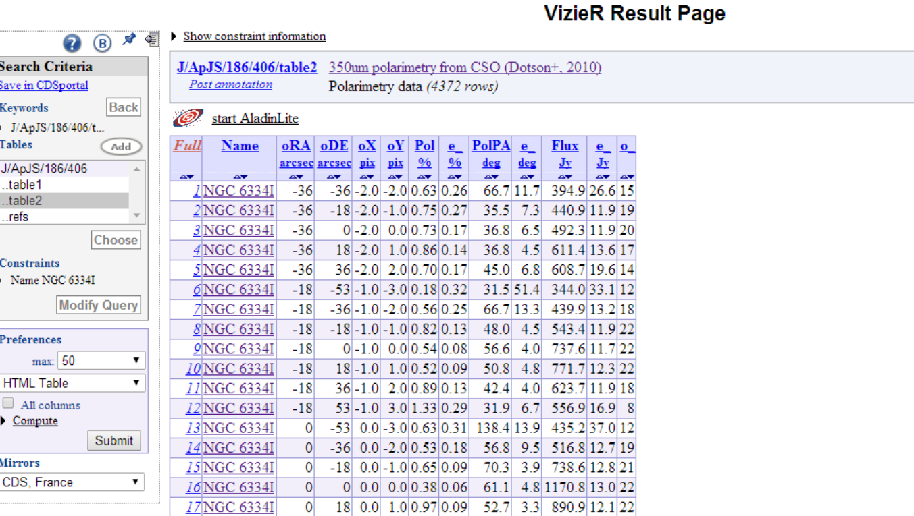
Method : A look on original data
Data is from 350 μm Polarimetry from the Caltech Submillimeter Observatory .
Coordinate
Polarization angle (E of N)
Intensity

Slide 12
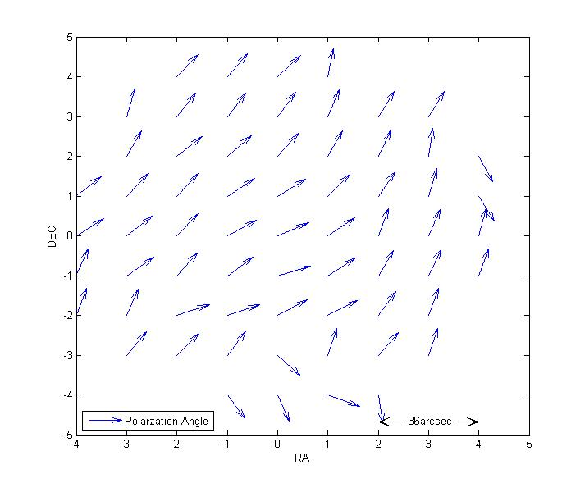
Method : A look on original data
Thing to do :
1. rotate them by 90
degrees
2.connect them
Fig 1 . Originally polarization angle of NGC6334I

Slide 13
Method : Connecting vector
The method of connecting B field line is adopted from the paper TRACING TURBULENT AMBIPOLAR DIFFUSION IN MOLECULAR CLOUDS
Stroke parameter need to be consider when adding polarization vector
Fig 2. Illustration of connecting B field.
Notes:
In fig 2. Each solid grid represents the size of a pixel with B field vector, which is perpendicular to the polarization vector, at the center of each grid. To draw a B field line, a square with the size of a pixel (dotted grid) is draw with the head of the blue arrow as the center, then the stoke parameter Q and U of the four grid overlapped with the dotted grid was found. The Q and U of the dotted square can be found by the weighted values by the overlapped area of the four grid, a new B field vector with size is found by equation (4) , by repeated this process a B field line can be drew .

Slide 14





Method : stroke parameter
invented by Sir George Stokes (Stokes 1901)
defines reduced Stokes parameters as the follows:
to determine the polarization angle when light is at superposition :
Resultant polarization angle
Notes:
What is Pi

Slide 15
Method : detail of drawing line
In both ngc6334I and DR21 , 5 B field line and 5 normal line is draw
C++ is used
Equal distance on B1
(0,2)
B4
(0,1)
B2
(0,0)
Distance indicate relative field strength
B1
(0,-1)
B3
(0,-2)
Dec
B5
RA
T5
T4
T3
T2
T1
(line not necessary be st. line)

Slide 16
Method : Compare to column density data
Mean field strength alone T is supposed to compare to mean column density alone T
Catastrophe : Unable to find online data about it !!!!( common tracer : 13CO ,18CO ,etc)
Emission intensity is used as substitution→ error introduced
Notes:
Mention only graph is provided

Slide 17
Method : Emission intensity Error
Slope is expected to be smaller then 1/2
ln B
Hotter
Column
density
intensity
colder
ln ρ

Slide 18
Result and discussion

Slide 19
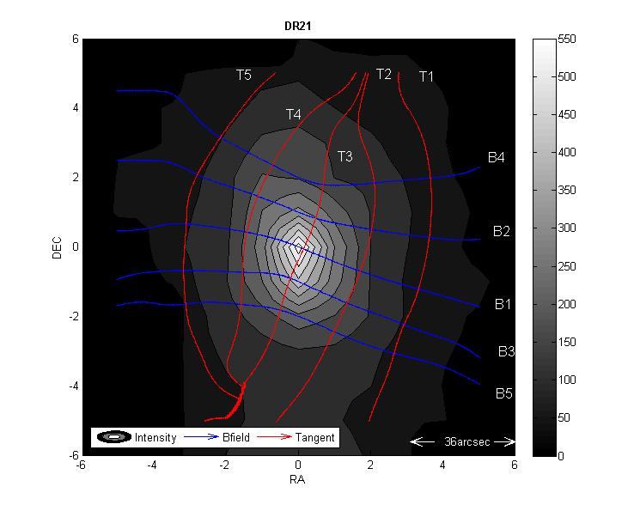
Fig 3. Map of DR21.
Notes:
DR 21 is a huge molecular cloud located in the constellation of Cygnus. This area is located about 6,000 light-years across and extends for 80 light-years. The region contains a large amount of massive star formation.

Slide 20
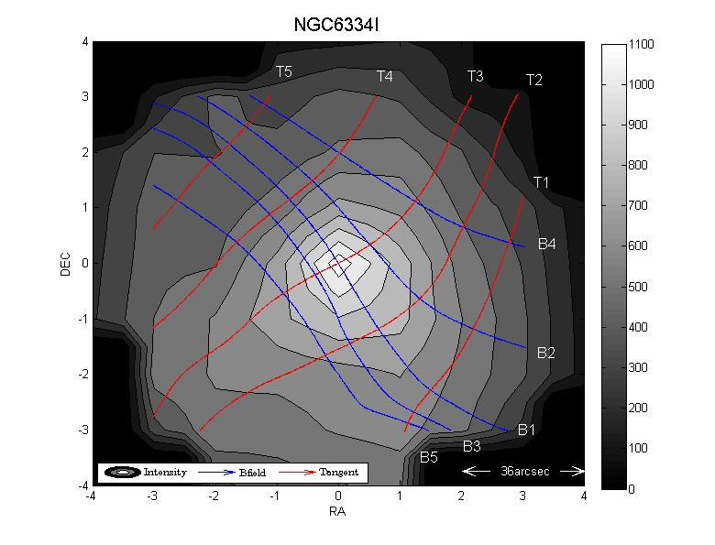
Fig 3. Map of NGC6334I.
Notes:
TypeEmission nebulaRight ascension17^{h} 19^{m} 58^{s[1]}Declination−35° 57′ 47″^{[1]}Distance 5500 +/-970 ly^{[2]} ConstellationScorpius

Slide 21
Result : DR21
Best fit slope found : 0.252 ± 0.065

Slide 22
Result:NGC6334I
Best fit slope found : -0.325 ± 0.218

Slide 23
Discussion :
Result for DR 21 fall in a expected range
Result for ngc6334I give a negative co-relation
More factor may need to consider : turbulence ?
Outflow ?
In fact there is turbulence in NGC 6334I

Slide 24
Next move …..
Find real data for column density ( or use map provided by other paper)
Programming details
Possible to find real B field strength by combining other method ?
a complete survey should be conducted(56 sources from the paper)

Slide 25
Conclusion
To conclude, a method using Polarimetry data from molecular cloud is introduced .The relation of B field and column density of NGC6334I and DR21 is found and expected to be fit in the flux freezing assumption. However it is not the case, therefore further investigation is needed.

Slide 26
Reference
[1] Kohji Tomisaka (2012). Chandrasekhar-Fermi Method. [ONLINE] Available at: http://th.nao.ac.jp/MEMBER/tomisaka/Lecture_Notes/StarFormation/node79.html. [Last Accessed 7/5/2014].
[2] Dotson, Jessie L.; Vaillancourt, John E.; Kirby, Larry; Dowell, C. Darren; Hildebrand, Roger H.; Davidson, Jacqueline A., (2010). 350 μm Polarimetry from the Caltech Submillimeter Observatory. The Astrophysical Journal Supplement, Volume 186, . 2, pp. (2010) (), pp. 406-426
[3] R. H. Hildebrand J. A. Davidson, J. L. Dotson,C. D. Dowell,G. Novak, J. E. Vaillancourt1, (2000). A Primer on Far‐Infrared Polarimetry. Publications of the Astronomical Society of the Pacific.
[4]Li, Hua-bai; Houde, Martin; Lai, Shih-ping; Sridharan, T. K., ( 2010). Tracing Turbulent Ambipolar Diffusion in Molecular Clouds. The Astrophysical Journal. Volume 718 ( Issue 2), pp.905-912

Slide 27
Acknowledgment
I would like to thank Prof Li, Dr Leung and Frank for supervising this project, it is the first time that I conduce a research in physics, although I have little result in this project at the time, I have learnt a lot about Astronomy and research method, which I am deeply enjoyed.

Slide 28
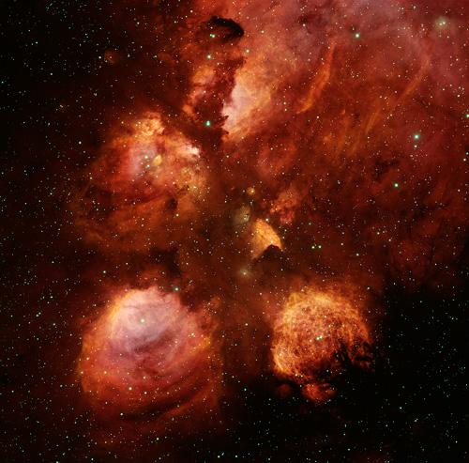
Q and A
Picture to neutralize the boring present !
ngc6334
http://www.noao.edu/image_gallery/html/im1040.html

Slide 29
The end

Slide 30
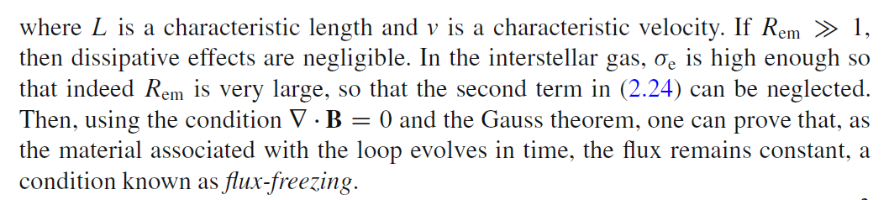

Slide 31
Abstract
The Magnetic Field of star forming molecular cloud plays an important role on compressing the cloud and forming stars .Therefore it is important to study about the relationship between the magnetic field and the column density of molecular cloud. This report will present a simple method of determining the relative strength of magnetic field in a cloud by using polarization data from the Caltech sub millimeter observatory, this method is then used to verify the flux freezing condition of molecular cloud. Two source , NGC6334I and DR21 is considered in this project

